Slide 1
Git and Github Introduction

Slide 2
What is Git
Git is a free and open source software that provides a version control system for tracking changes in computer files and coordinating work on those files among multiple people.
It is primarily used for source code management in software development, but it can be used to keep track of changes in any set of files.
Git stores data as a series of snapshots of the content that has been staged. This is generally stored in a hidden folder called .git/

Slide 3
Installing Git
To check if you have git installed go to a command line and type:
git --version
If this does not respond with a version of git then you need to install Git
Goto the Git download page at : https://git-scm.com/downloads
Download a version of Git for your platform and follow the installation instructions.
Once installed you will be able to create and manage local repositories of your source code.

Slide 4
What is Github
GitHub is a web-based hosting service for version control using git. It is mostly used for computer code. It offers all of the distributed version control and source code management (SCM) functionality of Git as well as adding its own features. It provides access control and several collaboration features such as bug tracking, feature requests, task management, and wikis for every project.
GitHub offers plans for both private repositories and free accounts which are commonly used to host open-source software projects. As of April 2019, GitHub reports having almost 36 million users and over 100 million repositories, making it the largest host of source code in the world.

Slide 5

Github Education Version
Github Provides a student version so you don’t have to pay for Github while you are a student!
To get this visit: https://education.github.com/

Slide 6
Start using Github
Github can be very intimidating to first time users. Let’s start with the basics
Let’s get used to the Github UI!
If you haven’t signed up yet, let’s do that first!

Slide 7
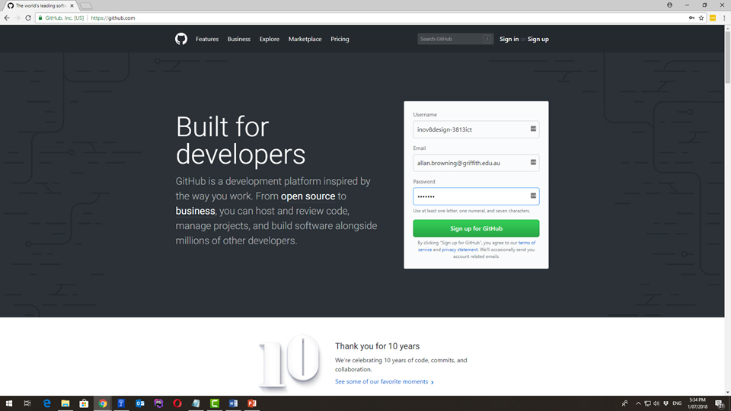
Start using Github

Slide 8
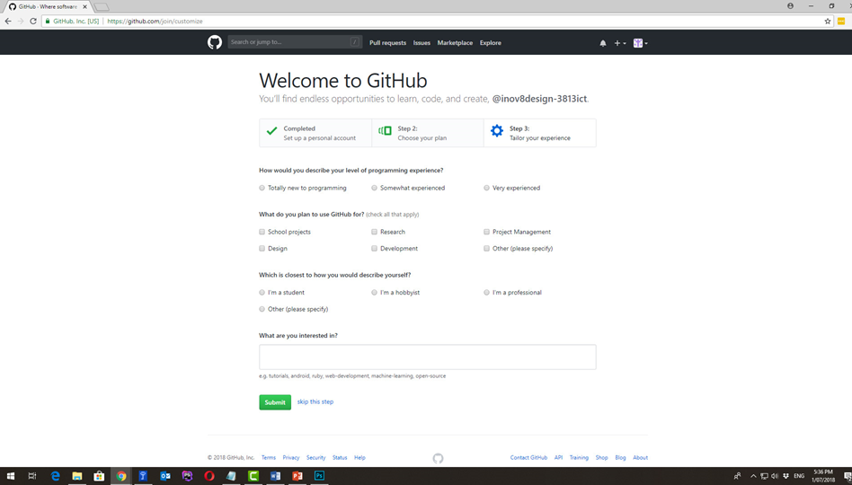
Start using Github

Slide 9
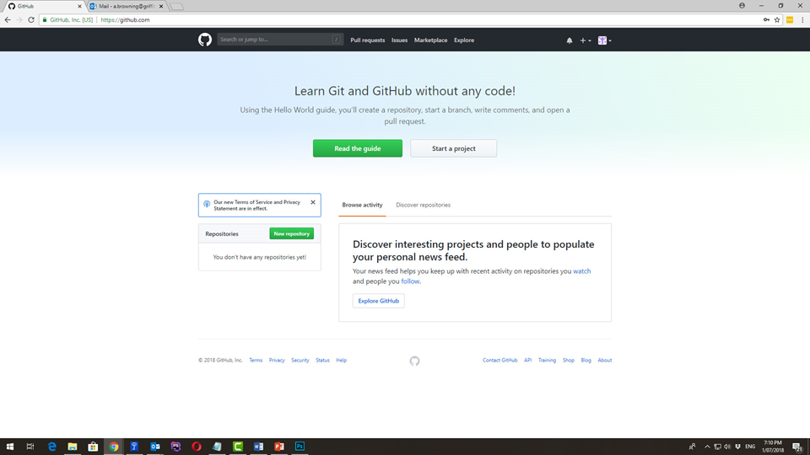
Start using Github

Slide 10
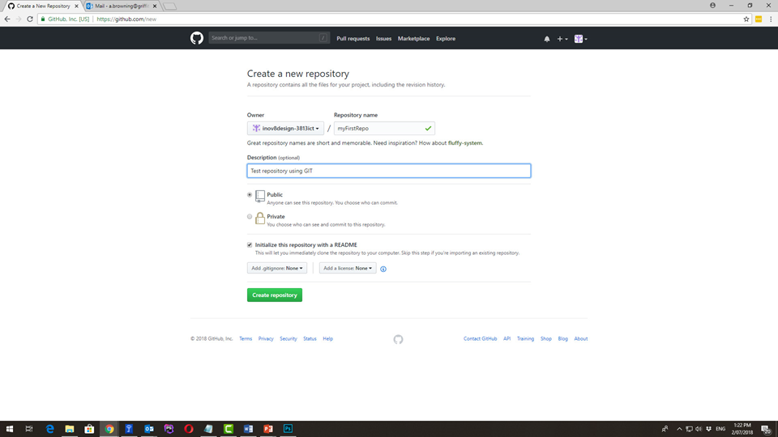
Start using Github

Slide 11
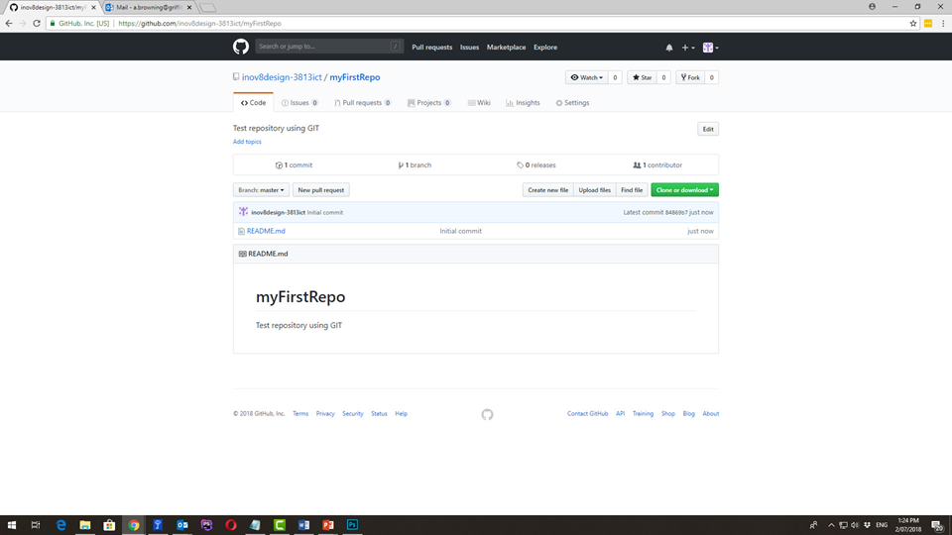
Start using Github

Slide 12
Readme Files
A README file contains information about other files in a directory or archive. A form of documentation, it is usually a simple plain text file called READ.ME, README.TXT, README.md, or simply README, that uses Markup language.
The file name is usually written in Uppercase letters. This is to make the file more recognizable and it is something that you want users to look at first. File names starting with a capital letter will be listed before lowercase names in ASCIIbetical sorting, which also helps makes the file visible at first glance.

Slide 13
Readme Files
Your project should always contain a README file with a general overview of the package.
The readme file can contain:
The name of the package
The version number of the project
General description of what the project does
Instructions on how to install the project
Any known issues and possible fixes for certain operating systems
Authors (and some of them have donation links)

Slide 14
Markdown Language
Markdown is a lightweight markup language with a plain text formatting syntax. Markdown is used to define structure of a document. The text produced can be converted to many output formats. Typically it is converted to HTML by a markdown tool.
John Gruber created the Markdown language in 2004 in collaboration with Aaron Swartz. The goal of Markdown is to enable people to write an easy-to-read and easy-to-write plain text format.
https://help.github.com/articles/basic-writing-and-formatting-syntax/

